Slide 1
Introduction to ggplot2
- PALLAV ROUTH

Slide 2

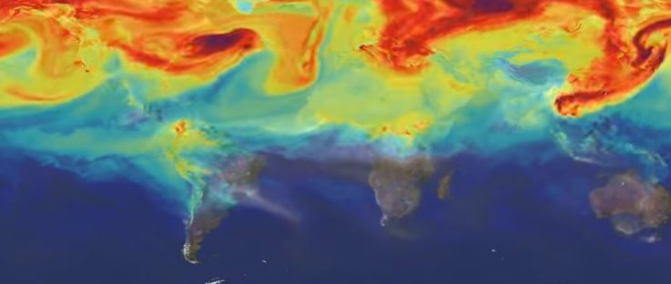
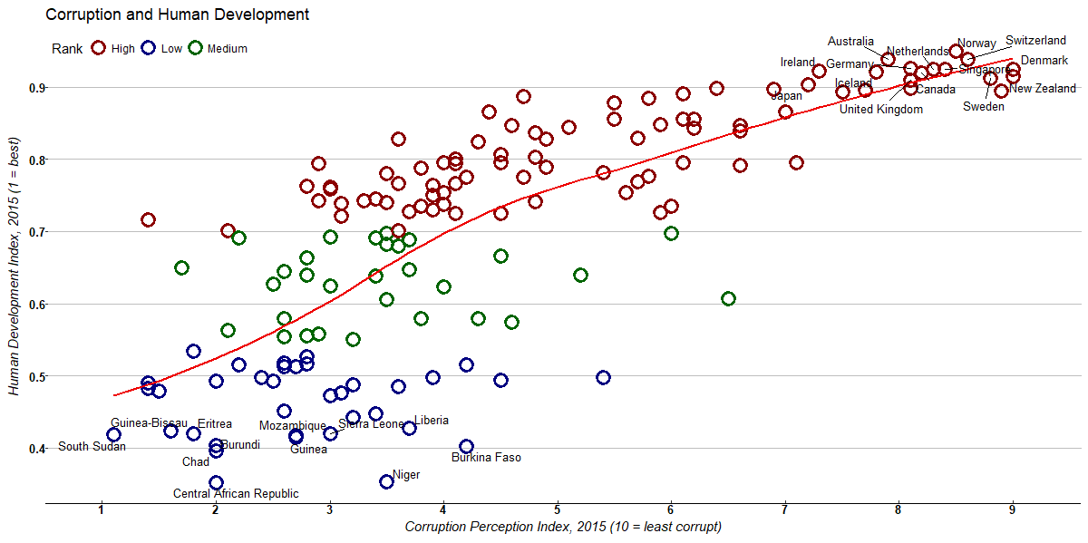
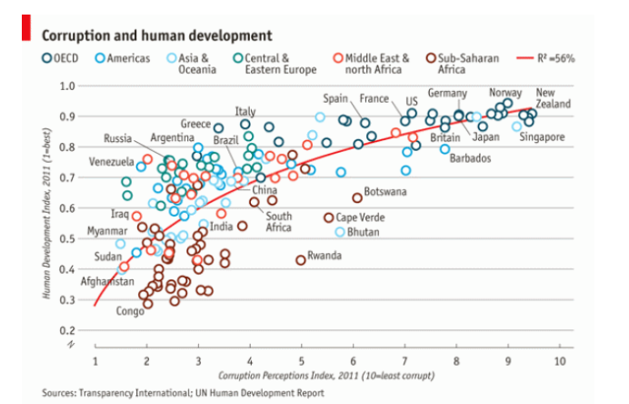
What is ggplot2?
ggplot2 is an advanced graphics package in R which implements the grammar of graphics to build plots
The package was first written by Hadley Wickham in 2005
Motivation:
Source: https://www.economist.com/blogs/dailychart/2011/12/corruption-and-development
Source: https://svs.gsfc.nasa.gov/cgi-bin/details.cgi?aid=11719

Slide 3
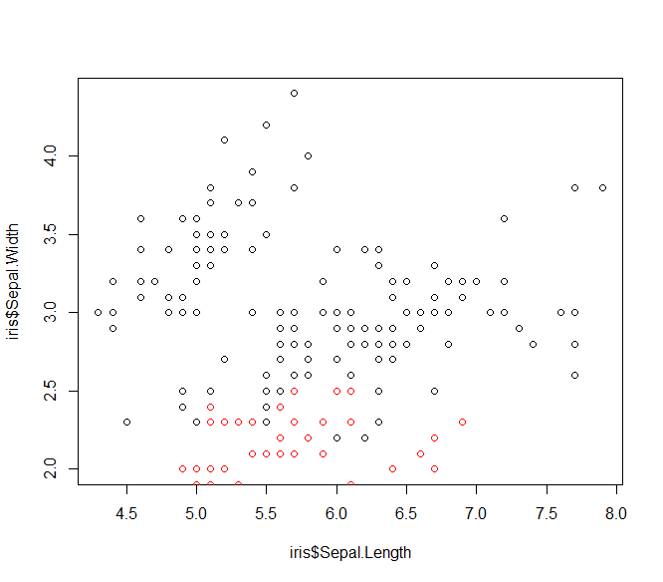
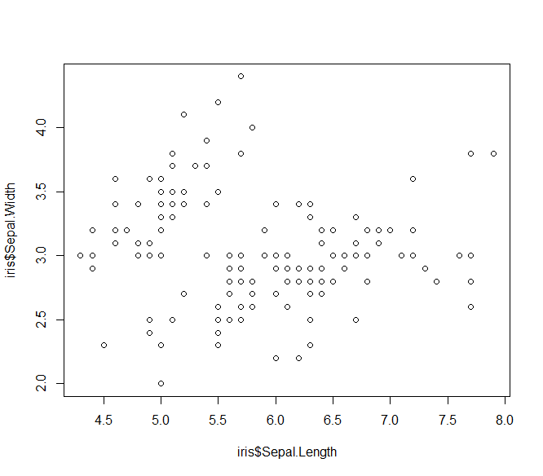
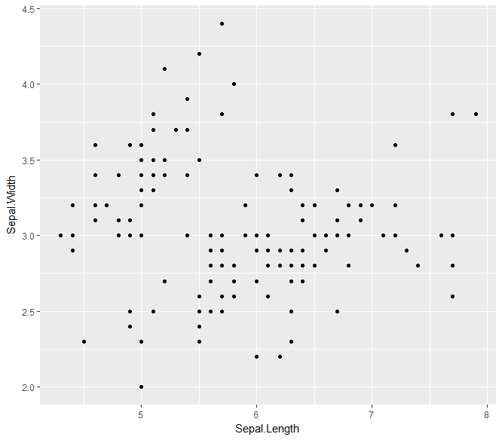
Why not base plot?
data
aesthetics
geometry
Its too wordy
No unified system of plotting
Plot does not get redrawn
Plot is drawn as an image
plot(iris$Sepal.Length,iris$Sepal.Width)
points(iris$Petal.Length,iris$Petal.Width, col = "red")
ggplot(iris, aes(Sepal.Length,Sepal.Width))+geom_point()
plot(iris$Sepal.Length,iris$Sepal.Width)

Slide 4
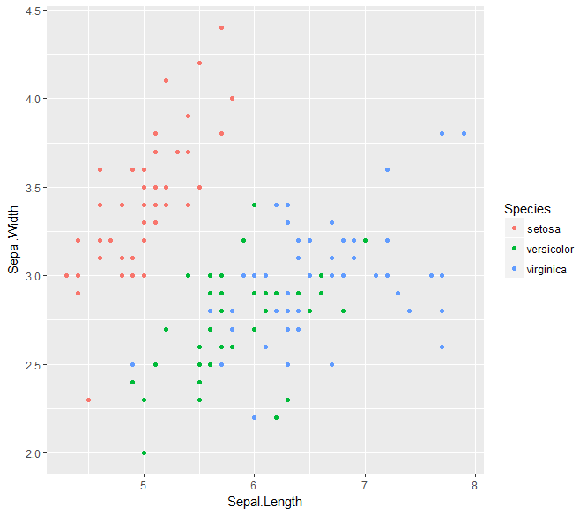
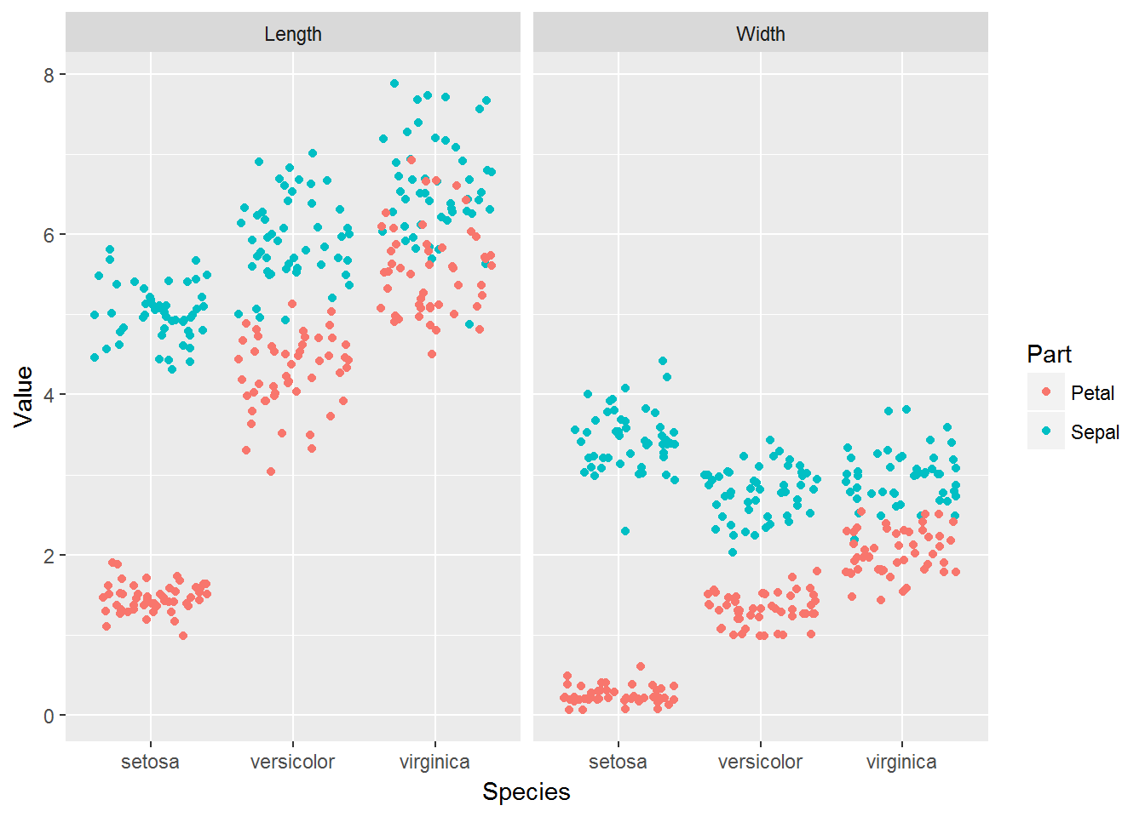
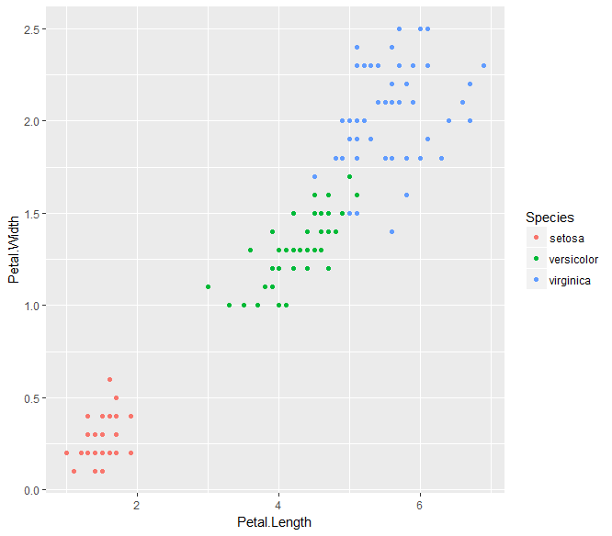
Grammar of Graphics
Plotting framework suggested by Leland Wilkinson in his book The Grammar of Graphics in 1999.
Two important aspects:
Graphical components are made of distinct layers
Accurate plotting through aesthetic layers
Example of an inefficient plot:
Example of an efficient plot
library(tidyr)
iris.tidy <- iris %>%
gather(key, Value, -Species) %>%
separate(key, c("Part", "Measure"), "\\.")
ggplot(iris.tidy, aes(x = Species, y = Value, col = Part)) + geom_jitter() + facet_grid(. ~ Measure)

Slide 5
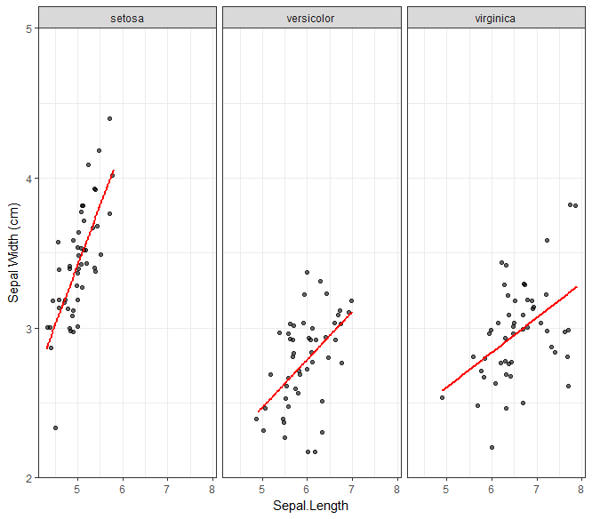
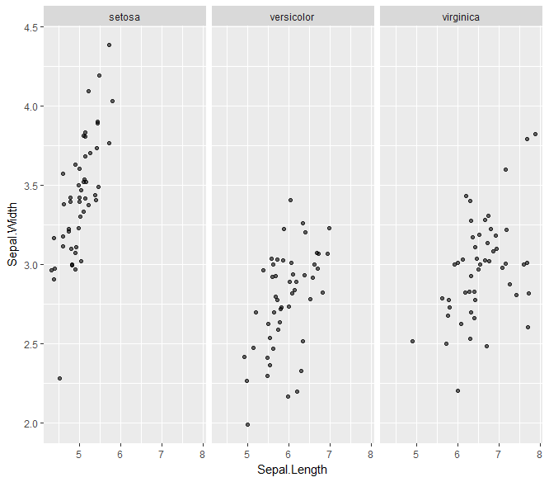
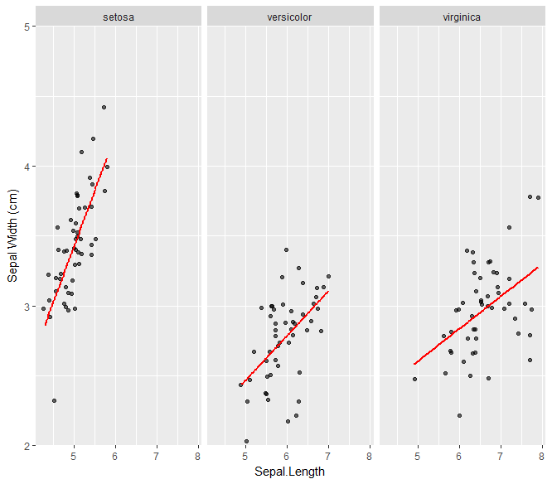
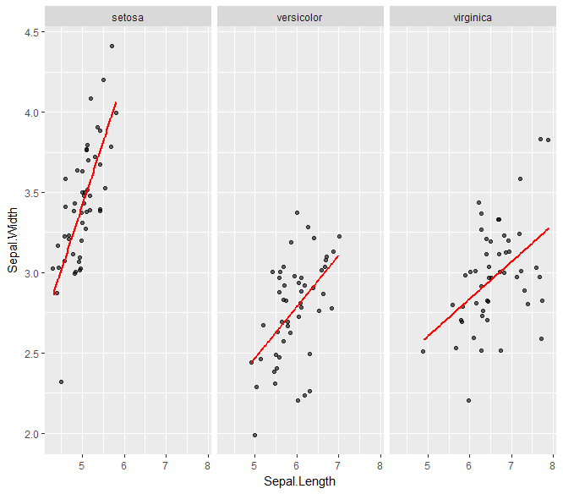

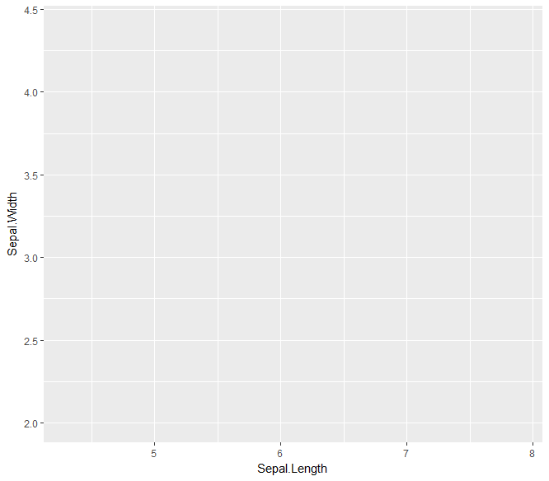
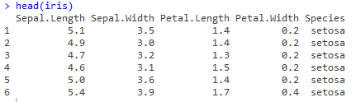
Architecture of ggplot2
ggplot(iris, aes(Sepal.Length,Sepal.Width))+geom_jitter(alpha = 0.6)+ facet_grid(.~Species)+stat_smooth(method = "lm",se = F, col = "red")+scale_y_continuous("Sepal Width (cm)",limits = c(2,5),expand = c(0,0))+theme_bw()
ggplot(iris, aes(Sepal.Length,Sepal.Width))+geom_jitter(alpha = 0.6)+facet_grid(.~Species)+stat_smooth(method = "lm",se = F, col = "red")+scale_y_continuous("Sepal Width (cm)",limits = c(2,5),expand = c(0,0))
GGPLOT2 Layers:
ggplot(iris,aes(Sepal.Length,Sepal.Width))+geom_jitter(alpha = 0.6)+facet_grid(.~Species)
ggplot(iris, aes(Sepal.Length,Sepal.Width))+geom_jitter(alpha = 0.6)
ggplot(iris, aes(Sepal.Length,Sepal.Width))+geom_jitter(alpha = 0.6)+ facet_grid(.~Species)+stat_smooth(method = "lm",se = F, col = "red")
ggplot(iris, aes(Sepal.Length,Sepal.Width))
Theme
Coordinates
Statistics
Facets
Geometries
Aesthetics
Data

Slide 6
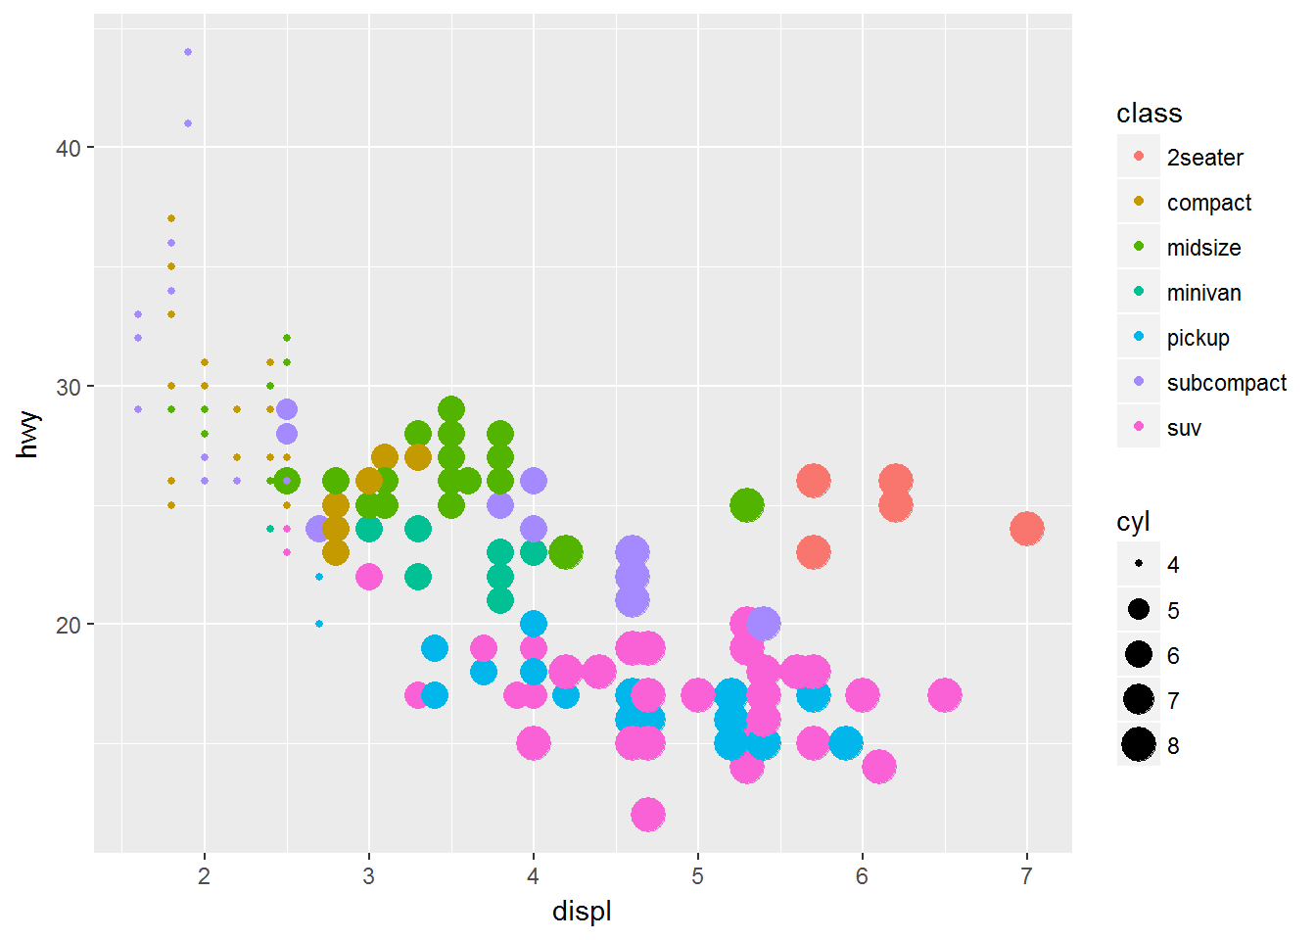
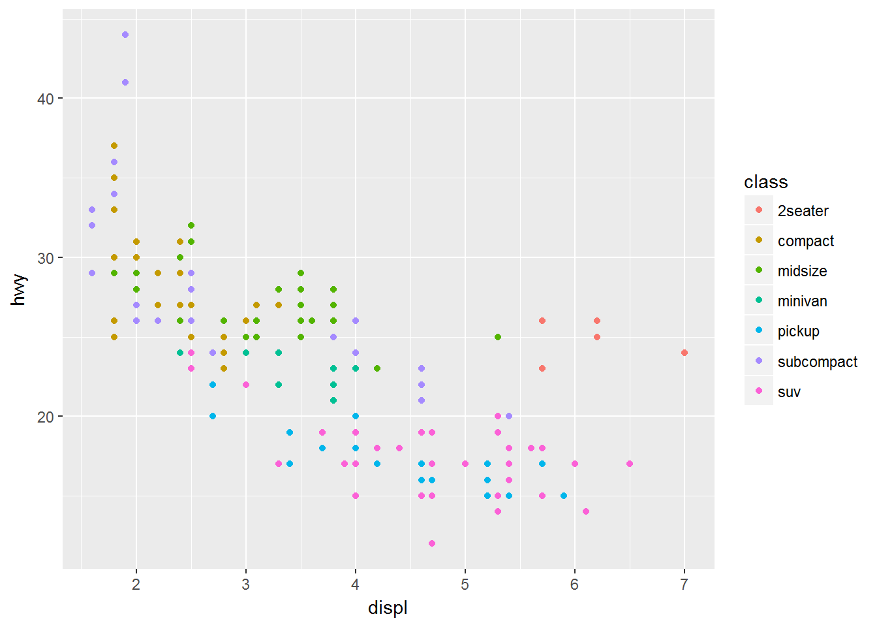
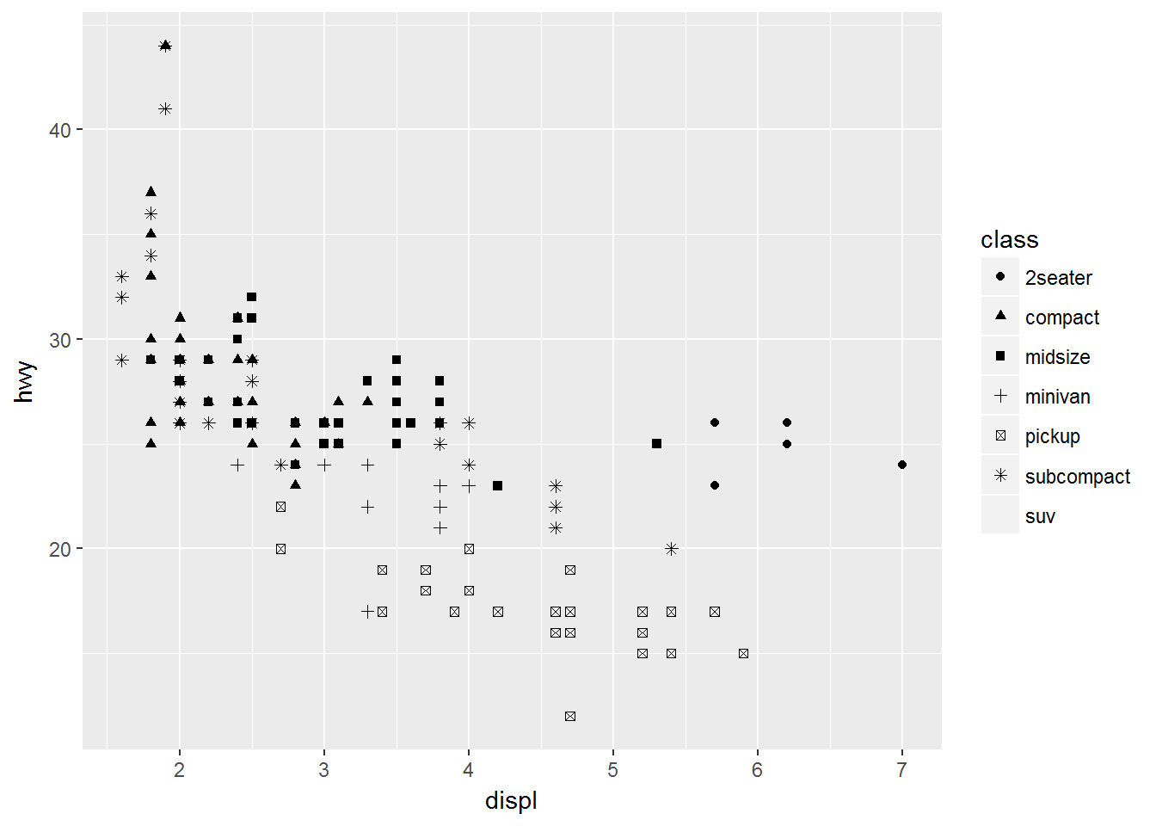
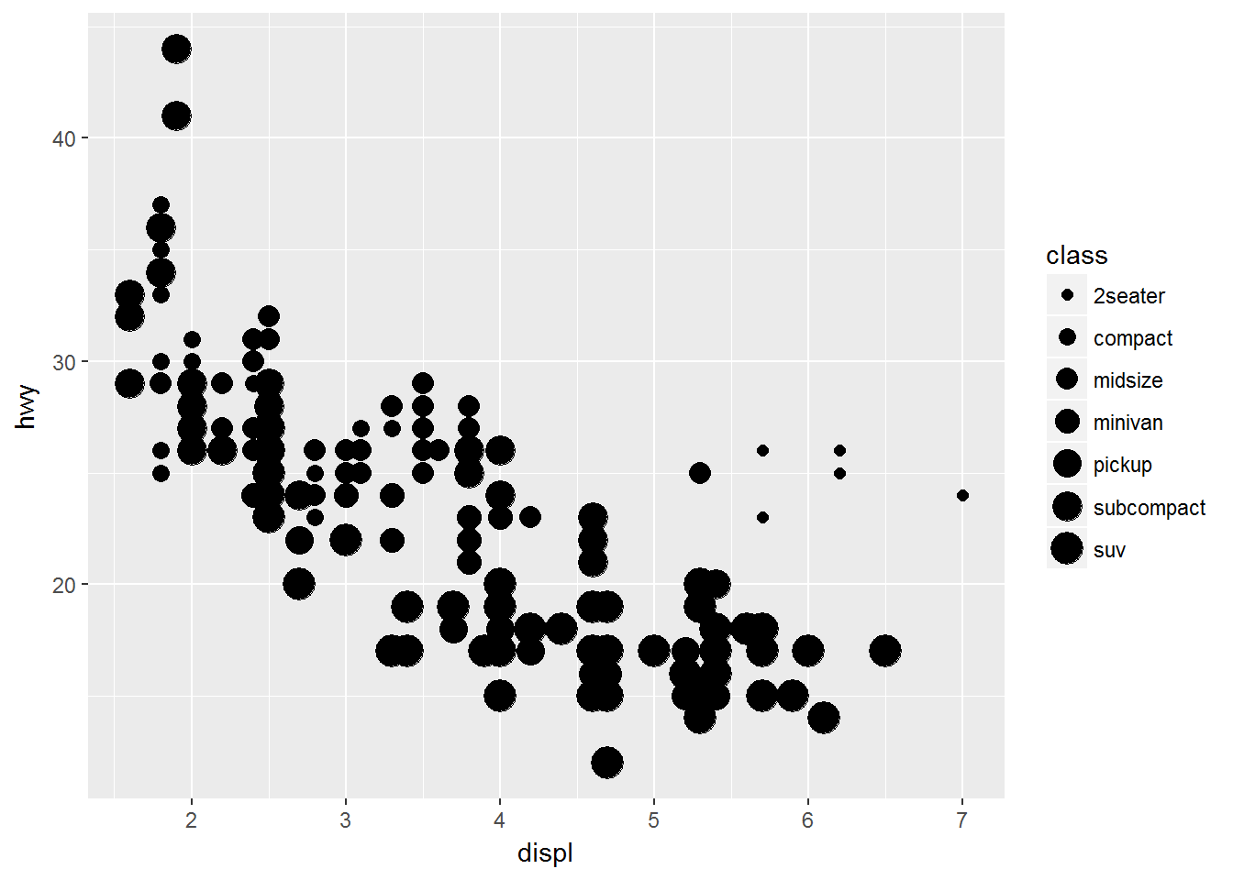
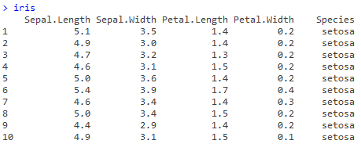
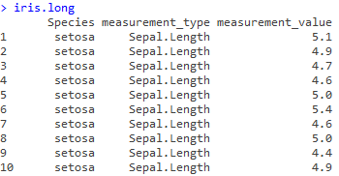
The Base Layer
This layer contain the specifications of data set being used for plotting
Creates a ggplot object
This layer contains the aesthetics, a.k.a attributes or scales onto which we map the data
The attributes include:
x and y axis
Color
Size
Shape
Fill
Linetype, Linewidth
Alpha blending
Important to have the data in the correct format:
Concept of tidy data
Long vs Wide data
library(tidyr)
iris.long <- gather(iris, key = measurement_type,
value = measurement_value, -Species)

Slide 7
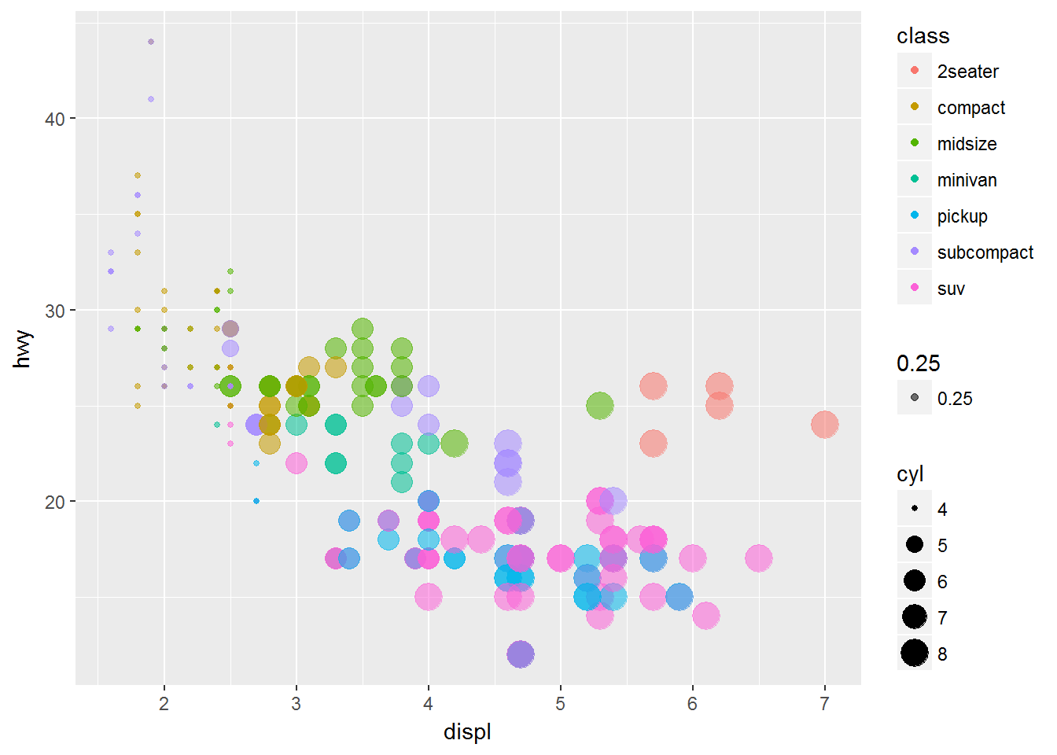
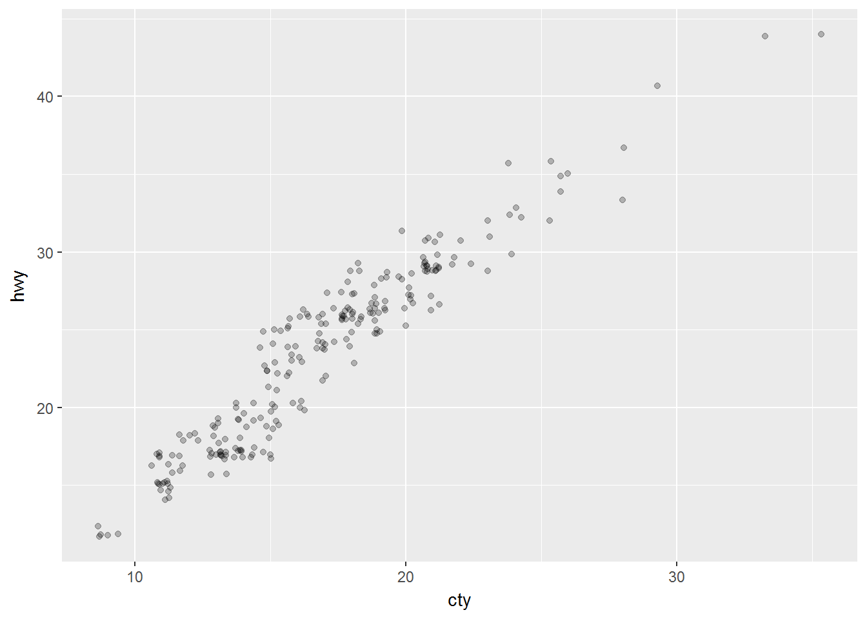
Geometry Layer (Part I): GEOM POINt
Used to create scatter plots
Useful for showing relationships between two continuous variables, or even a continuous and categorical (with modifications)
Key arguments:
Position: There are 6 positions – identity, dodge, stack, fill, jitter and jitterdodge
Color
Fill
Size
Shape

Slide 8
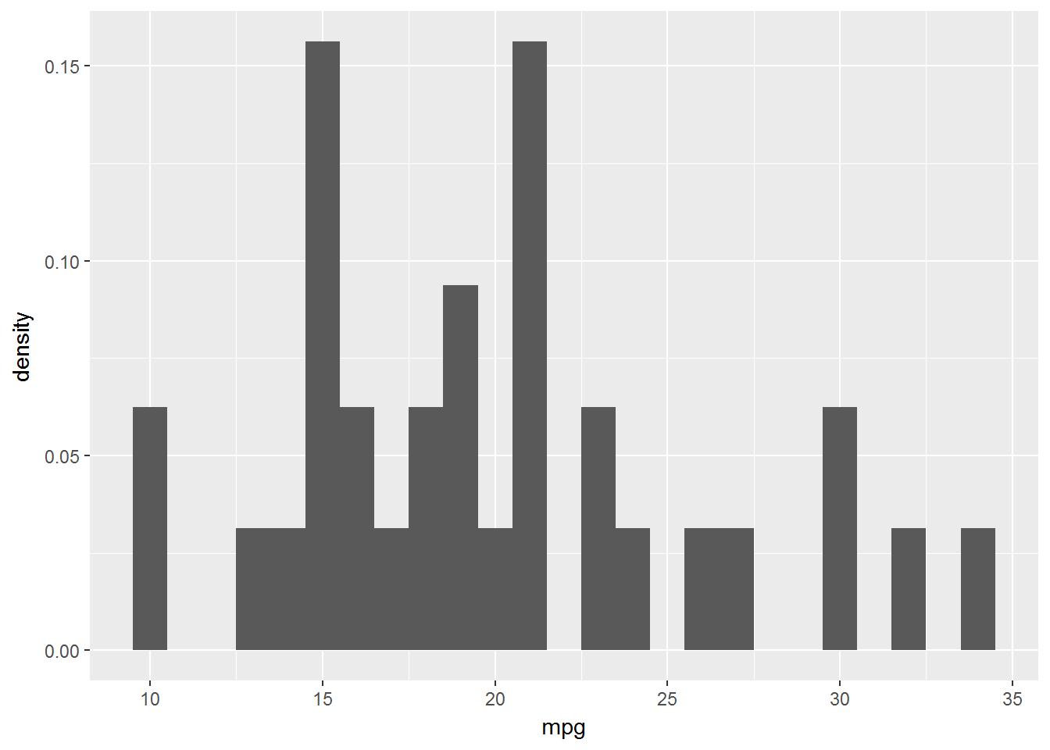
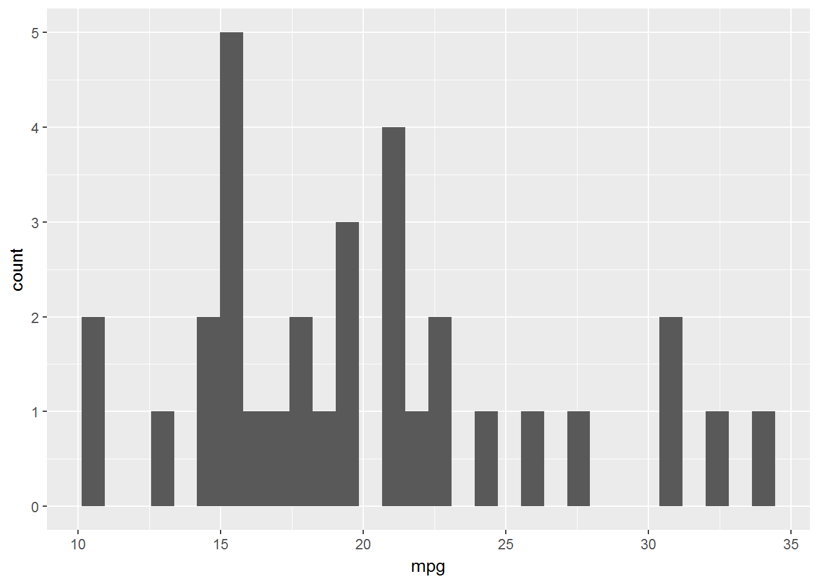
Geometry Layer (Part II): GEOM HISTOGRAM
Histograms are one of the most common and intuitive ways of showing distributions usually of continuous variables.
Key aesthetics:
x aesthetic: histograms cut up a continuous variable into discrete bins
y aesthetics: there’s no y aesthetic!
Use position and alpha blending to modify aesthetic layer
Use ‘stat’ argument to count instances on the fly
A close alternative: geom density

Slide 9
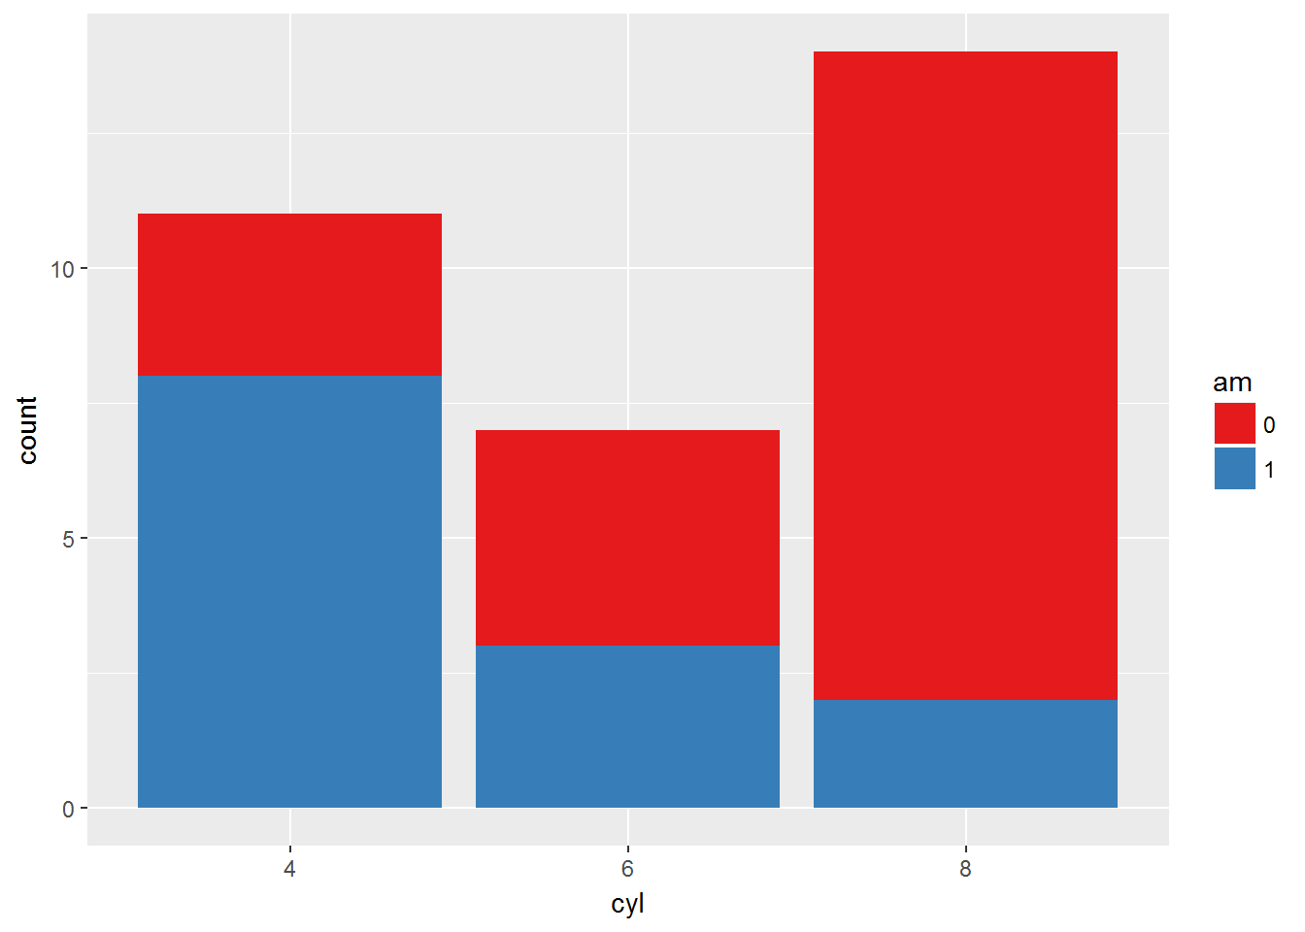
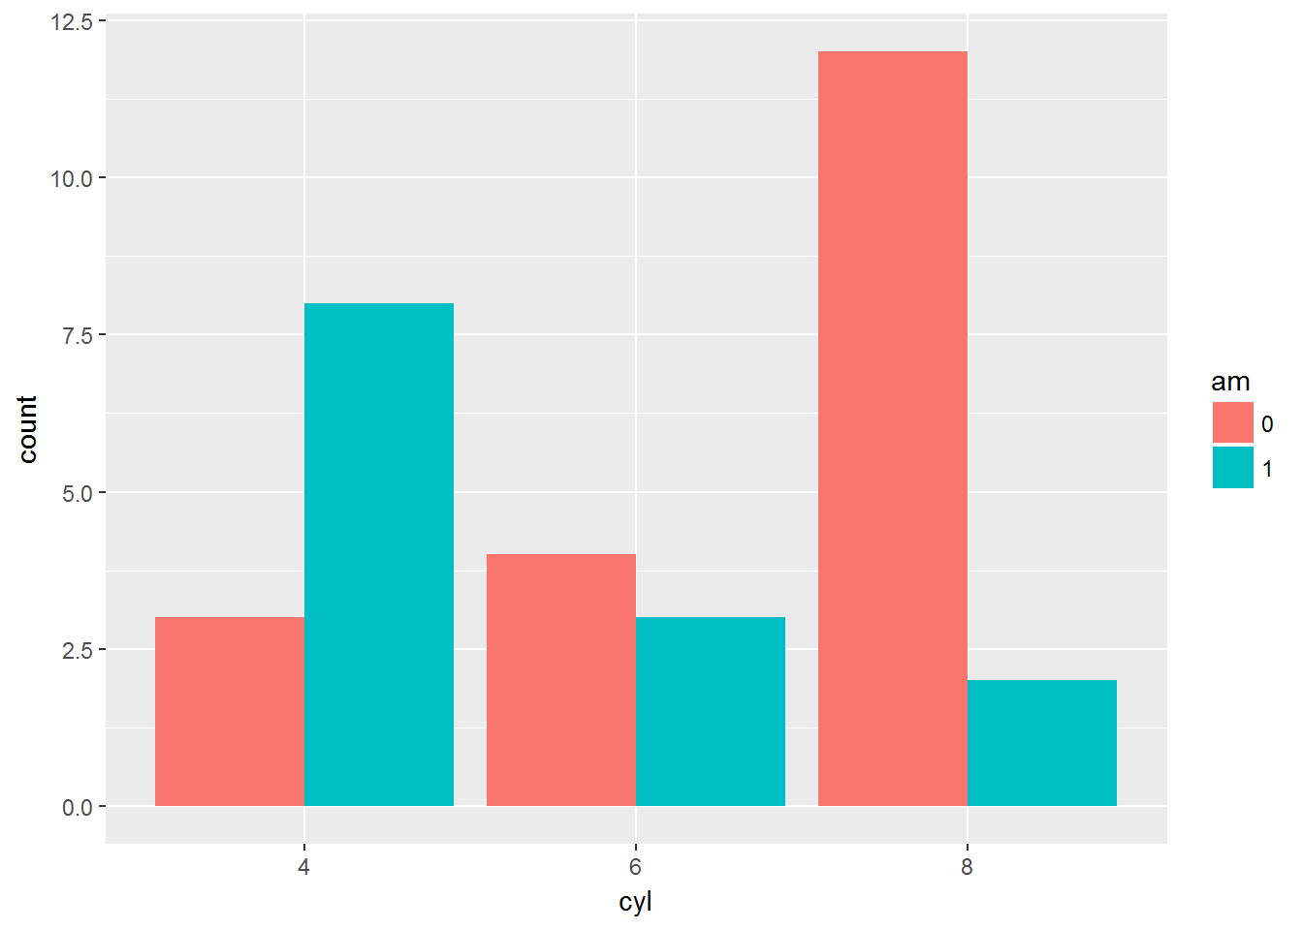
Geometry Layer (Part III): GEOM BAR
A bar chart or bar graph is a chart or graph that presents categorical data with rectangular bars with heights or lengths proportional to the values that they represent
Improve aesthetics with position dodge, stack, fill, color and alpha

Slide 10
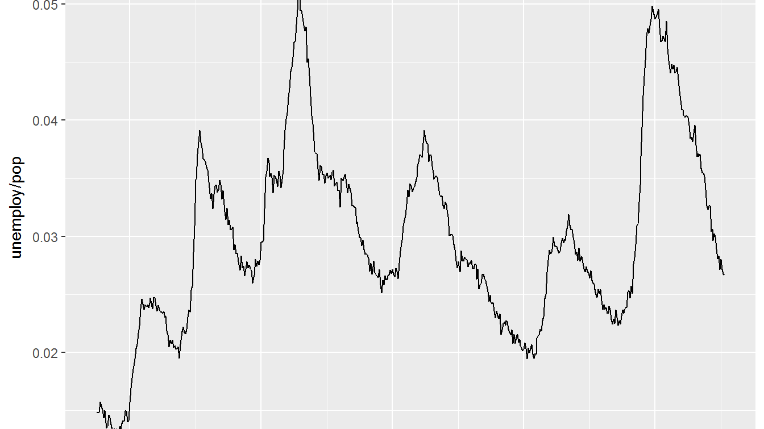
Geometry Layer (Part IV): GEOM LINE
A line plot connects the data points in order of the x axis variable
Ideally used to show time series plots
Multiline plots can capture more than one category of variable
Improve aesthetics by using line-width, line-type, the color ,alpha or size.

Slide 11
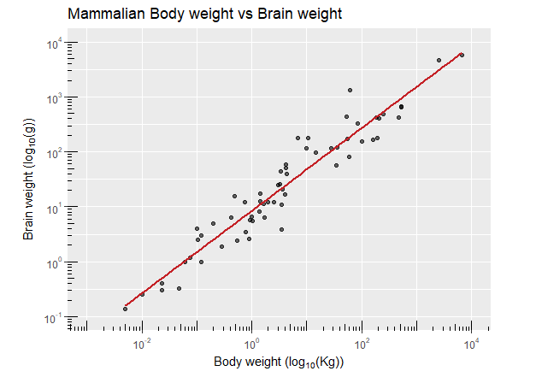
Cleaning up A plot
Add x- axis and y-axis label : xlab() and ylab()
Add title : ggtitle()
Or add together : labs()
Important scale functions:
scale_x_continuous or scale_x_discrete
scale_y_continuous or scale_y_discrete
scale_color_manual or scale_fill_manual
Use theme_bw() or theme_classic()
Limits to x and y axis: xlim() and ylim()
ggplot(mammals, aes(x = body, y = brain))+ annotation_logticks()+
geom_point(alpha = 0.6)+
coord_fixed(xlim = c(10^-3, 10^4), ylim = c(10^-1, 10^4))+ scale_x_log10(expression("Body weight (log"["10"]*"(Kg))"),
breaks = trans_breaks("log10", function(x) 10^x),
labels = trans_format("log10", math_format(10^.x)))+
scale_y_log10(expression("Brain weight (log"["10"]*"(g))"),
breaks = trans_breaks("log10", function(x) 10^x),
labels = trans_format("log10", math_format(10^.x)))+
stat_smooth(method = "lm", col = "#C42126", se = FALSE, size = 1) +
ggtitle("Mammalian Body weight vs Brain weight")+
theme_classic()
Credits: Rick Scavetta

Slide 12
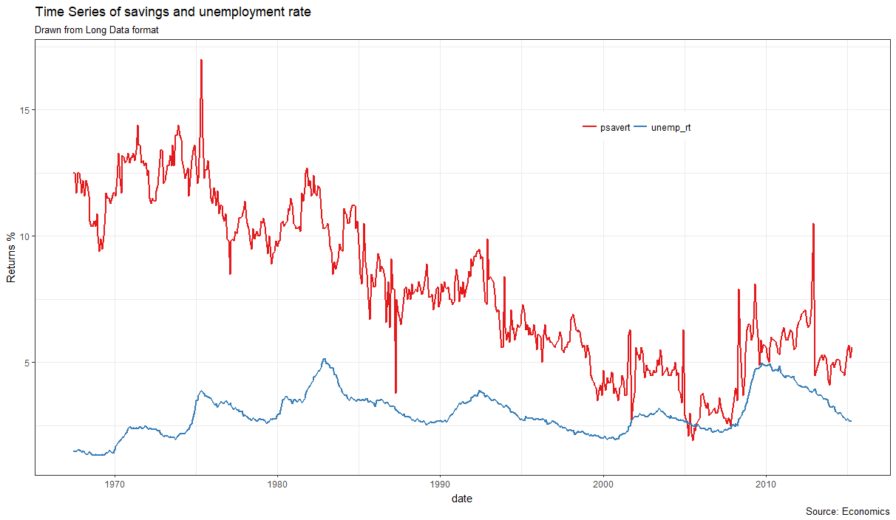
The Goal

Slide 13
Resources
List of hexadecimal color codes: http://htmlcolorcodes.com/
Tidyverse::ggplot2: http://ggplot2.tidyverse.org/
Hadley Wickham blog: http://hadley.nz/
Other useful ggplot2 resources:
Official book: https://www.amazon.com/dp/0387981403/ref=cm_sw_su_dp?tag=ggplot2-20
ggplot2 documentation: http://ggplot2.tidyverse.org/reference/
ggplot2 cheat sheet: https://www.rstudio.com/wp-content/uploads/2015/03/ggplot2-cheatsheet.pdf
A good starting tutorial: https://rpubs.com/g_jw/ggplot2_tutorial
Hadley Wickham interview: https://www.youtube.com/watch?v=JxwxefRAu70
Getting help: https://stackoverflow.com/
Datasets used:
Diamonds: http://ggplot2.tidyverse.org/reference/diamonds.html
Economics: http://ggplot2.tidyverse.org/reference/economics.html
Iris: https://stat.ethz.ch/R-manual/R-devel/library/datasets/html/iris.html

Slide 14
Thank you! Happy plotting

